Slide 1
Tokens, Expression Evaluation & Type Casting
Sultan Mahmud,
Lecturer
Dept. of ICT, NIYD

Slide 2
Agenda
Tokens
Expression Evaluation
Type Casting

Slide 3
Tokens
A token is the smallest element of a program that is meaningful to the compiler. Tokens can be classified as follows:
Keywords
Identifiers
Constants
Strings
Special Symbols
Operators
#include<stdio.h>
int c, d;
int main()
{
int a, b;
return 0;
}

Slide 4
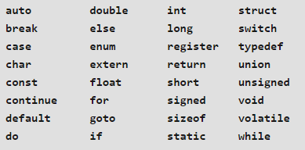
Keywords

Slide 5
Identifiers / Variables
There are certain rules that should be followed while naming c identifiers:
They must begin with a letter or underscore(_).
They must consist of only letters, digits, or underscore. No other special character is allowed.
It should not be a keyword.
It must not contain whitespace.
It should be up to 31 characters long as only first 31 characters are significant.

Slide 6
Constants
Constants are also like normal variables. But, only difference is, their values can not be modified by the program once they are defined. Constants refer to fixed values. They are also called as literals.
Constants may belong to any of the data type.Syntax: const data_type variable_name; (or) const data_type *variable_name;
Example : #define pi = 3.1416

Slide 7
Strings
Strings are nothing but an array of characters ended with a null character (‘\0’).This null character indicates the end of the string. Strings are always enclosed in double quotes. Whereas, a character is enclosed in single quotes in C and C++.

Slide 8
Special Symbols
Brackets[]
Parentheses()
Braces{}
comma (, )
semi colon (;)
asterick (*)
assignment operator(=)
pre processor(#)

Slide 9
Operators
Unary Operators (++, --)
Binary Operators
Arithmetic operators
Relational Operators
Logical Operators
Assignment Operators
Conditional Operators
Bitwise Operators
Ternary Operators (? :)

Slide 10
Bitwise Operators vs. Logical Operators (*Class Discussion Slide with O4)
Bitwise Operators
& |
Logical Operators
&& ||
A = 10 , B = 20
# A > 10 && B <= 20
= F && T = F = 0
Bitwise Operators
& |
Logical Operators
&& ||
A = 15 , B = 15
# A & B
= 15

Slide 11
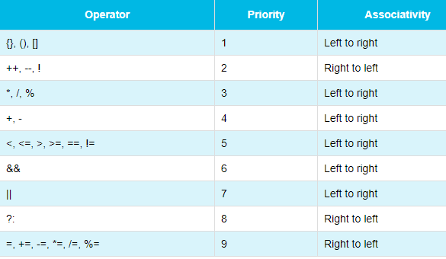
Expression Evaluation

Slide 12
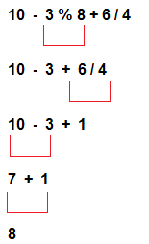
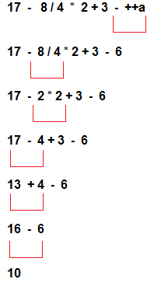
Expression Evaluation

Slide 13
Type Casting
Implicit
Example:
char val = ‘a’;
int num = val;
Explicit
Example:
char val = ‘a’;
int num =(int) val;

Slide 14
Thanks
A = A * B + D / C + + + C - - - D [A=10, B =15,C= 5, D=20 ]
=> A = (A*B) + (D/C) + (++C) - (--D)
=> A = 150+ 4 + (++C) - (--D) //
=> A = 150 + 4+ 6 - 19 // C = 6 , D = 19
=> A = 150 + 4 + 6 - 19
=> A = 150 + 4 + 6 - 19
=> A = 141 // A = 141, B = 15, C = 6 , D = 19

